Slide 1
On SNEIPL (software networks extractor) – a part of the SSQSA back end
Miloš Savić, Gordana Rakić, Zoran Budimac and
Mirjana Ivanović
Department of Mathematics and Informatics Faculty of Sciences University of Novi Sad

Slide 2
Content
Introduction
Extraction procedure
GDN extraction
Experiments and results
Conclusion and future work
9/4/2012 9:07:34 PM
2

Slide 3
Introduction
Sneipl: software networks extractor that uses eCST representation of source code
Software networks: graphs reflecting dependencies among software entities (classes, functions, variables, etc.)
Set of eCST trees
SNEIPL Software Networks Extractor Independent of Programming Language
Set of software networks
9/4/2012 9:07:34 PM
3

Slide 4
Introduction
Output set of software networks function & variable level: static call graph “function → global variable” network class/module level: class/module collaboration network CCN/MCN restricted by specific type of coupling strong/weak aggregation, inheritance forest,… package level: package collaboration network vertical: hierarchy tree

Slide 5
Content
Introduction
Extraction procedure
GDN extraction
Experiments and results
Conclusion and future work
9/4/2012 9:07:35 PM
5

Slide 6
Extraction procedure
Sneipl uses unification model provided by eCST generator to extract GDN (General Dependency Network)
Nodes in GDN corresponds to: PACKAGE_DECL (package/namespace/…) CONCRETE_UNIT_DECL (class/imp. module/…) INTERFACE_UNIT_DECL (interface/def. module/…) FUNCTION_DECL (method/function/…) TYPE_DECL (UDTs) ATTRIBUTE_DECL (class attr./global var./…) eCST universal nodes
Following eCST universal nodes are used to form GDN links: IMPORT_DECL EXTENDS IMPLEMENTS INSTANTIATES VAR_DECL BLOCK_SCOPE FUNCTION_CALL ARGUMENT_LIST ARGUMENT FORMAL_PARAM_LIST PARAMETER_DECL TYPE NAME
6

Slide 7
Extraction procedure
GDN link types: 1. REFERENCES USES CALLS and CONTAINS relations 2. REFERENCES subtypes: EXTENDS IMPLEMENTS GLOBAL_VAR LOCAL_VAR RET_TYPE FUNC_PARAM
By simple GDN filtering software networks are obtained: static call graph filter: select all GDN nodes that are FUNCTION_DECL connected by CALLS links class/module collaboration network filter: select all GDN nodes that are CONCRETE_UNIT_DECL or INTERFACE_UNIT_DECL connected by REFERENCES links etc.
7

Slide 8
Content
Introduction
Extraction procedure
GDN extraction
Experiments and results
Conclusion and future work
9/4/2012 9:07:35 PM
8

Slide 9
GDN extraction
GDN is incrementally built in two phases: Phase 1 forms GDN nodes and CONTAINS links Phase 2 forms GDN links of other types
GDN := emptyNetwork; (* phase 1 *) foreach eCST tree in inputSet: phase1Analyzer(currentTree, GDN) (* phase 2 *) foreach eCST tree in inputSet: phase2Analyzer(currentTree, GDN)
9/4/2012 9:07:35 PM
9

Slide 10
GDN extraction
Analyzers in both phases traverse an eCST tree level-by-level realizing trigger - deduce - action mechanism
Triggers: RED eCST universal nodes
Deduce in phase 1: hierarchy of RED universal nodes in the eCST tree
Deduce in phase 2: 1. hierarchy of RED and/or BLUE universal nodes in the eCST tree 2. import list (GDN nodes representing names visible outside an eCST tree that is currently analyzed) 3. relations among GDN nodes represented by GDN links
Actions: 1. create one or more GDN nodes/links 2. populate import list 3. rewrite eCST sub-tree with one node
9/4/2012 9:07:35 PM
10

Slide 11
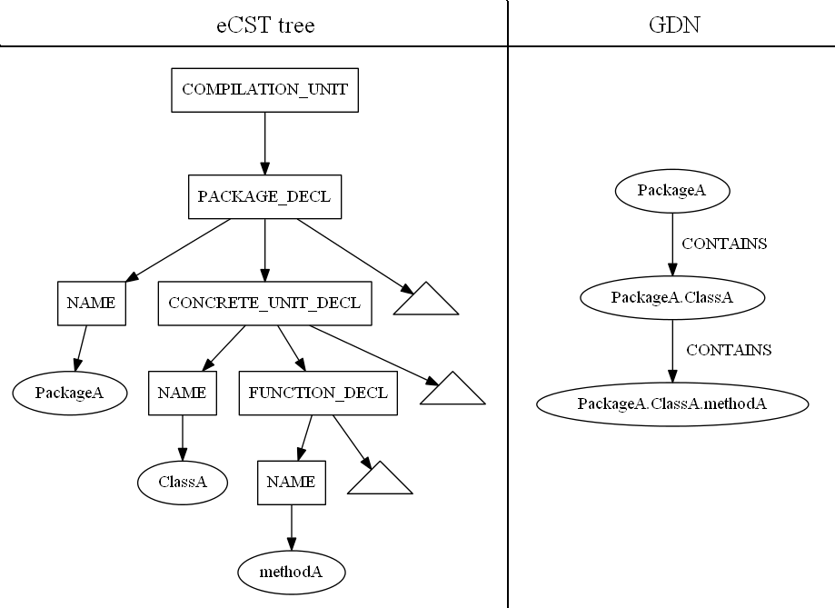
Phase 1
9/4/2012 9:07:35 PM
11

Slide 12
Phase 2
IMPORT_DECL: populates import list
TYPE: creates REFERENCES links REFERENCES type: first hierarchically above BLUE
NAME: creates USES links triggered only if in some FUNCTION_DECL → BLOCK_SCOPE
FUNCTION_CALL: creates CALLS links
REFERENCES links for C_U_D/I_U_D induce REFERENCES links for P_D CALLS and USES links can induce REFERENCES links for C_U_D/I_U_D and P_D
9/4/2012 9:07:35 PM
12

Slide 13
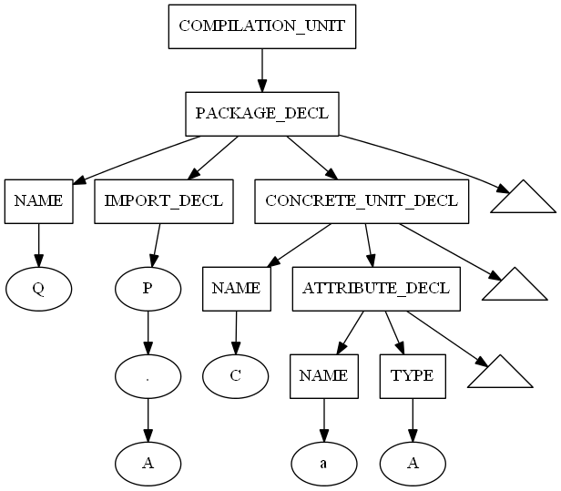
Phase 2
trigger : IMPORT_DECL
deduce : imported C_U_D “A” from P_D “P” represented by the GDN node “P.A”
action : add GDN node “P.A” to import list
trigger: TYPE deduce: 1. “A” referenced in GDN “Q.C” scope 2. BLUE == ATTRIBUTE_DECL
3. “A” == C_U_D “P.A” action:
“Q.C” → “P.A” (REFERENCES link) “Q.C” → “P.A” (GLOBAL_VAR link) “Q” → “P” (induced REFERENCES link)
9/4/2012 9:07:35 PM
13

Slide 14
FUNCTION_CALL
deduce-action on FUNCTION_CALL trigger is postponed
FUNCTION_CALL action rewrites FUNCTION_CALL sub-tree with function return type
function call → function definition match: 1. first try using name and number of arguments 2. in the case of complex FUNCTION_CALL → NAME (“object.method”): perform RAPID TYPE ANALYSIS for NAME 3. if multiple candidates for function definition: perform RAPID TYPE ANALYSIS for ARGUMENT_LIST → ARGUMENTs
9/4/2012 9:07:38 PM
14

Slide 15
Content
Introduction
Extraction procedure
GDN extraction
Experiments and results
Conclusion and future work
9/4/2012 9:07:38 PM
15

Slide 16
Experiments and results
Student experiment: two equivalent programs written in Java and C#
Extraction of networks from large-scale software systems written in: - Java (antlrworks, lucene, tomcat) - Modula-2 (mas, lumos) - Delphi (proprietary project)
9/4/2012 9:07:38 PM
16

Slide 17
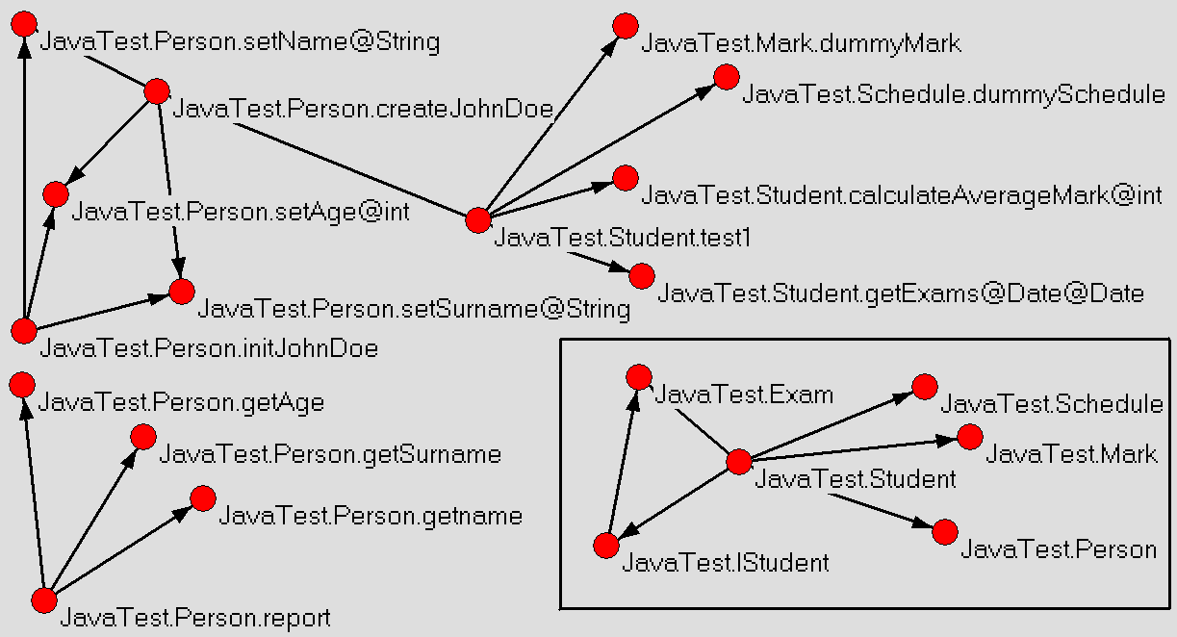
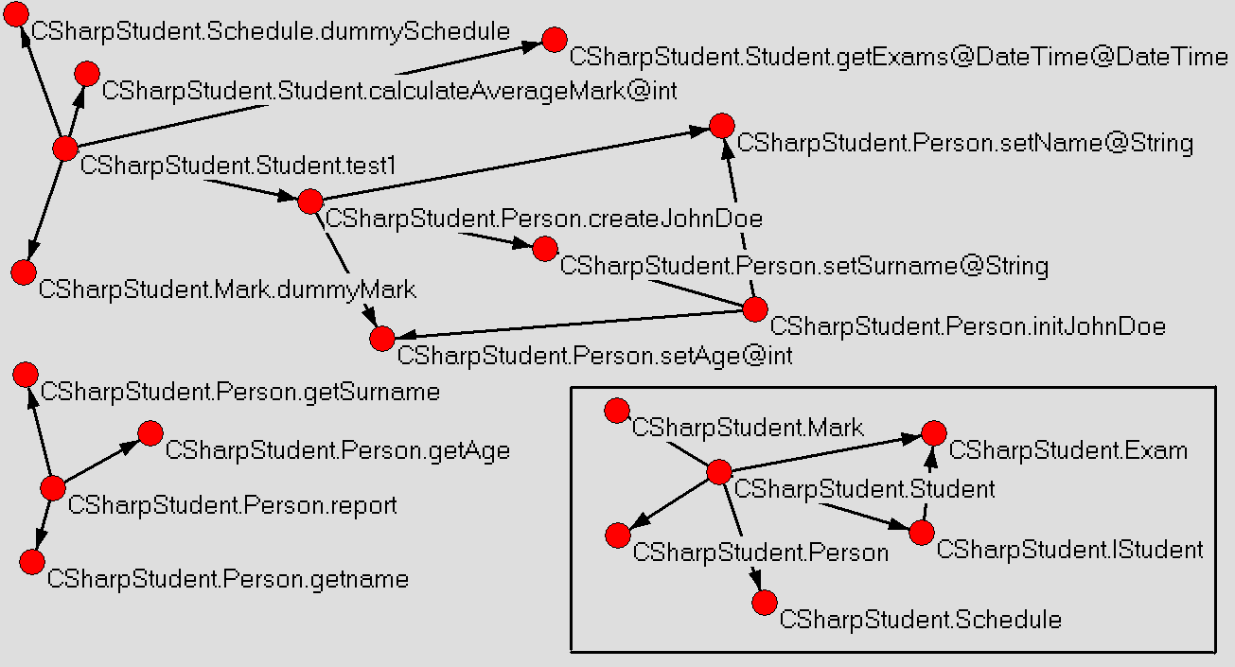
Student experiment
Structurally equivalent – the same hierarchy among entities (1 package, 5 classes, 1 interface, 25 methods)
Semantically equivalent – realize the same functionality
Only difference: written in different programming languages (Java/C#)
SNEIPL extracted ISOMORPHIC software networks (as expected)
9/4/2012 9:07:38 PM
17

Slide 18
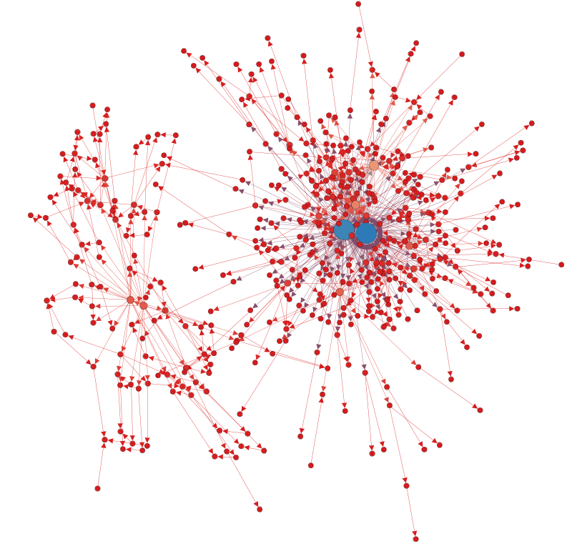
Delphi project – unit collaboration network
#nodes = 465 #links = 816 avg-deg = 1.755
diameter = 7 SW = 2.446 CC = 0.154 max(in-degree) = 147 max(out-degree) = 140 max(tot-degree) = 148
Blue nodes: - AmcCountrySpecProc (147, 1, 148) - MainAmcBs (2, 140, 142)
9/4/2012 9:07:38 PM
18

Slide 19
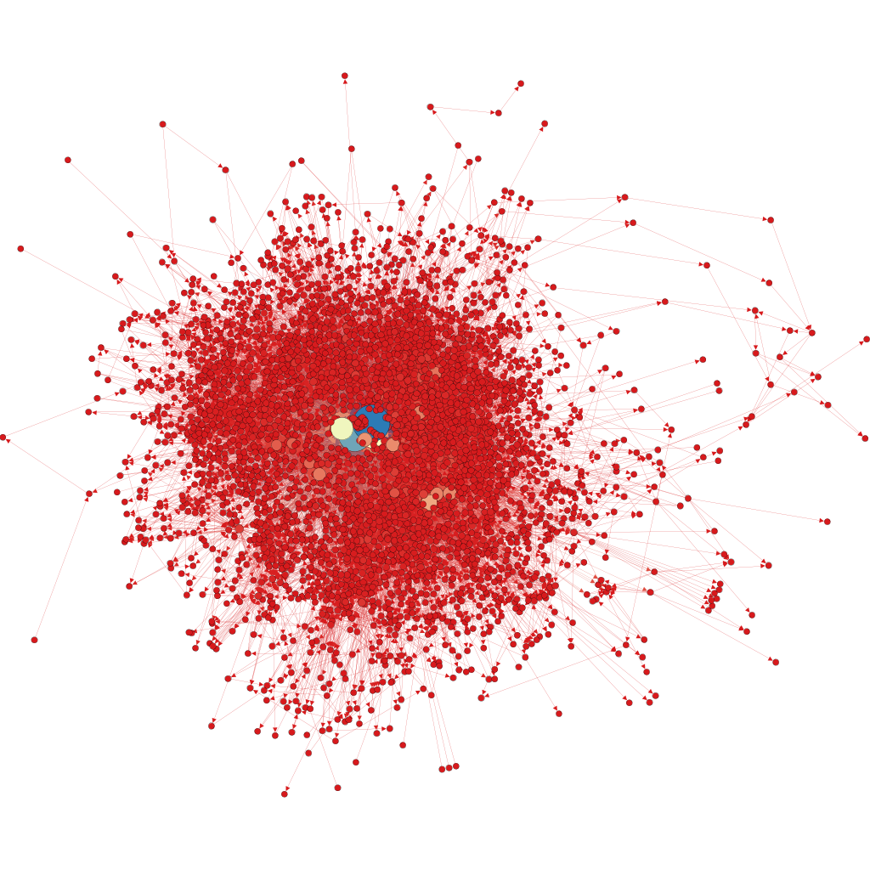
Modula-2 algebra system - SCG
#nodes = 3016
#links = 17450
avg-deg = 5.786
diameter = 12 SW = 3.586 CC = 0.086 max(in-degree) = 1132 max(out-degree) = 126 max(tot-degree) = 1134
Blue nodes:
MasStor.Adv (1132, 2, 1134) MasStor.Comp (949, 4, 953)
9/4/2012 9:07:38 PM
19

Slide 20
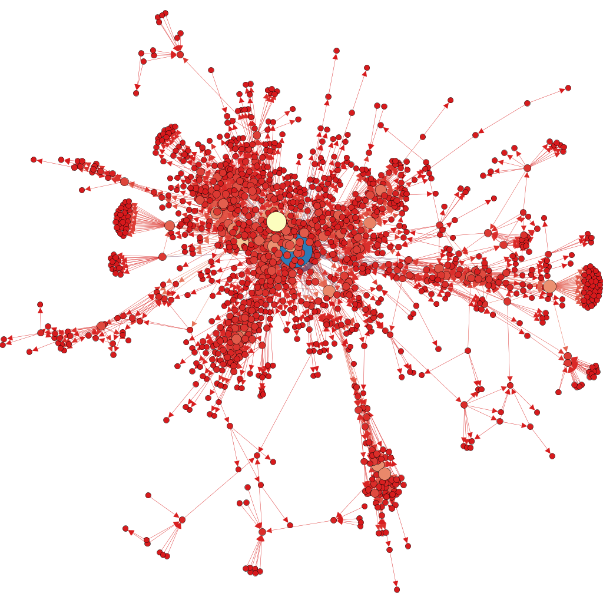
tomcat-7.0.29 (java soft.) - CCN
#nodes = 1384 #links = 4117
Giant WCC: #nodes = 1283 #links = 3937
avg-deg = 3.069 diameter = 16
SW = 5.839 CC = 0.146
max(in-deg) = 220 max(out-deg) = 55 max(tot-deg) = 220 blue node: org.apache.juli.logging.Log (220, 0, 220)
9/4/2012 9:07:38 PM
20

Slide 21
Content
Introduction
Extraction procedure
GDN extraction
Experiments and results
Conclusion and future work
9/4/2012 9:07:38 PM
21

Slide 22
Conclusion and future work
From a set of eCST trees is possible to extract software networks: - at different levels of abstraction - where trees represent software systems written in different programming languages - belonging to different programming paradigms
Extracted software networks can be used to: - investigate organizational complexity and structural evolution of software systems under the framework of complex network theory - calculate software metrics such as CBO, NOC, DIT, RFC, LCOM and Henry-Kafura complexity (fan-in and fan-out)
9/4/2012 9:07:38 PM
22

Slide 23
On SNEIPL (software networks extractor) – a part of the SSQSA back end
Miloš Savić, Gordana Rakić, Zoran Budimac and
Mirjana Ivanović
Department of Mathematics and Informatics Faculty of Sciences University of Novi Sad

